Slide 1


KUSHAGRA SINGH
30-06-2022

Slide 2

Outline
Executive Summary
Introduction
Methodology
Results
Conclusion
Appendix

Slide 3
Executive Summary
THE DATASET ON SPACEX FLIGHT TEST RESULTS CONTAINS DATA COLLECTED FROM SPACEX API AND WEB-SCRAPED PUBLIC DATA AVAILABLE ON WIKIPEDIA. THE CLEANING PROCESS INCLUDES FILTERING RESULTS THAT ARE EITHER FOR ANOTHER FALCON VERSION ROCKET, OR HAS OR DOES NOT HAS DATA THAT IS EITHER NOT-REQUIRED OR REQUIRED RESPECTIVELY. ALL VARIABLES HAVE BEEN CONVERTED TO WORKA BLE DATA-TYPES, WITH CATEGORICAL VARIABLES BEING ENCODED, OTHER DATA BEING SCALED TO BRING EVERYTHING ON A UNIVERSAL SCALE. EXPLORATORY DATA ANALYSIS SHOWS CORRELATION BETWEEN DIFFERENT VARIABLES. VARIOUS FINDINGS AND STATISTICS HAVE BEEN SHOWN LATER IN THE PRESENTATION. DASHBOARD AND OTHER VISUALIZATIONS PROVIDE A GOOD IDEA ABOUT VARIABLE DISTRIBUTIONS, TRENDS AND CORRELATIONS. CLASSIFICATION MODELS WITH DIFFERENT HYPERPARAMETERS HAVE BEEN FITTED WHICH YIELD A MAXIMUM OF APPROX. 84% TEST DATA ACCURACY, THEREBY ENABLING THE MODEL TO PREDICT IS A LAUNCH WILL BE SUCCESSFUL BASED ON THE FEATURES.

Slide 4
Introduction
THE PROJECT REQUIRES US TO COLLECT, CLEAN AND PROCESS DATA BASED ON SPACEX TEST LAUNCHES RESULT, ANALYZE TRENDS AND CALCULATE STATISTICAL VALUES, VIZUALIZE VARIOUS FEATURES AND BE ABLE TO FIND A MODEL WITH BEST PARAMETERS THAT CAN HELP PREDICT IF A TEST LAUNCH WOULD BE A SUCCESS OR FAILURE BASED ON AN ARRAY OF UNIQUE CHARACTERISTICS.
THE PROJECT EMPLOYS APPLICATIONS OF DATA SCIENCE METHODS AND PRESENTS ITS FINDINGS IN THIS PRESENTATION.

Slide 5

Section 1

Slide 6
Methodology
Executive Summary
Data collection methodology:
API AND WEB SCRAPING
Perform data wrangling
DATA CLEANING, SCALING, PRELIMINARY ANALYSIS
Perform exploratory data analysis (EDA) using visualization and SQL
Perform interactive visual analytics using Folium and Plotly Dash
Perform predictive analysis using classification models
How to build, tune, evaluate classification models

Slide 7
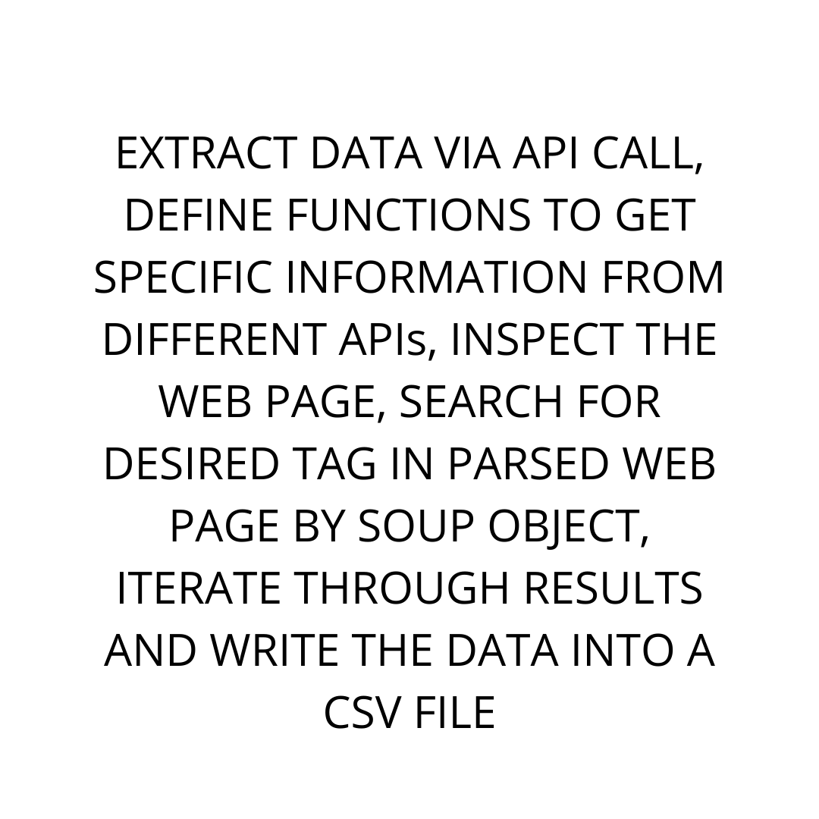
Data Collection
THE FIRST PART OF THE DATASET WAS COLLECTED USING SPACEX API (). THE DATA WAS PARSED AND COMPILED INTO A DATA FRAME. THE SECOND PART OF DATA WAS OBTAINED BY WEB-SCRAPING THE WIKIPEDIA PAGE FOR SPACEX FALCON LAUNCH RESULTS.

Slide 8
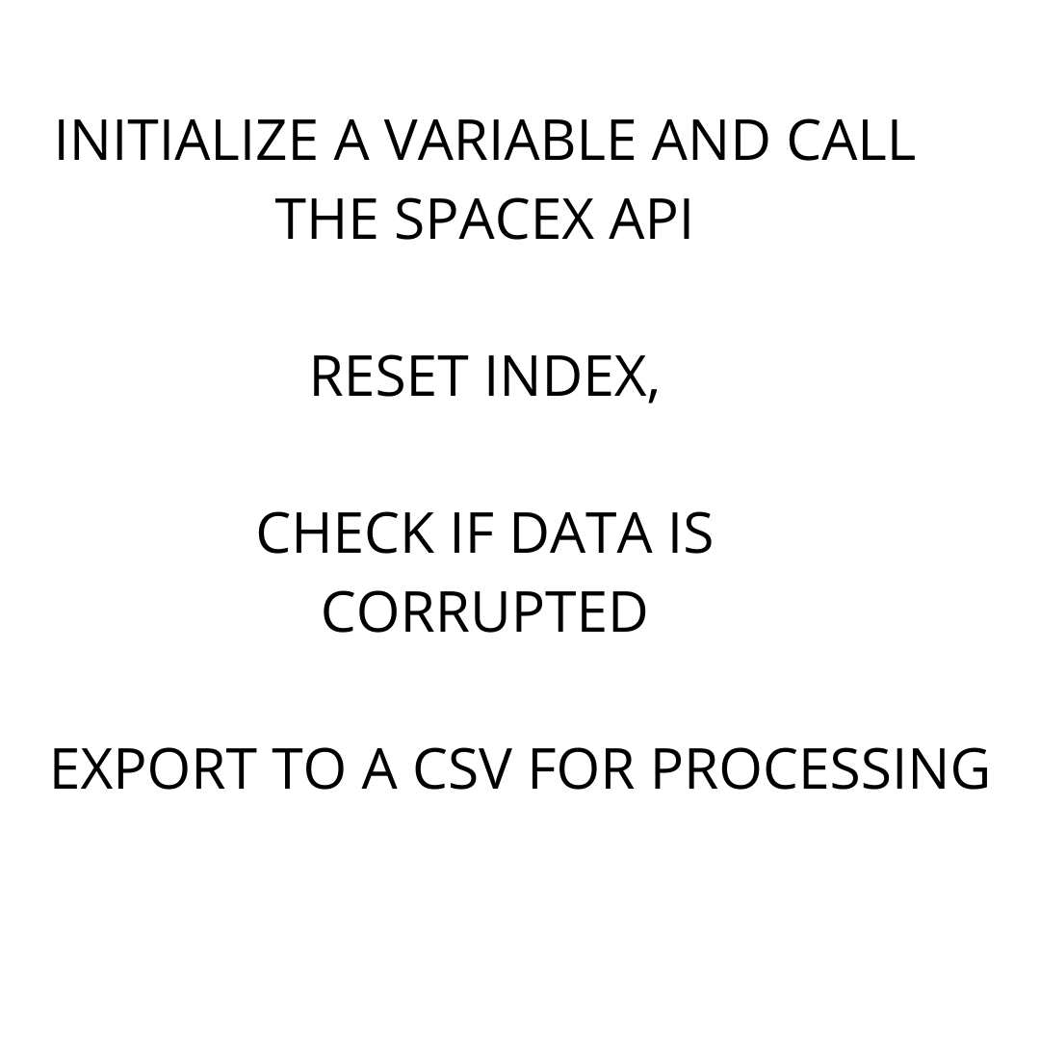
Data Collection – SpaceX API
SPACEX API USED: https://api.spacexdata.com/v4/launches/past
https://github.com/singhkushagra/IBMapplieddatasciencecapstone/blob/93b861fa9afe5c7b0cb757dfcb8e8eb991017892/1-Collecting%20the%20data.ipynb

Slide 9
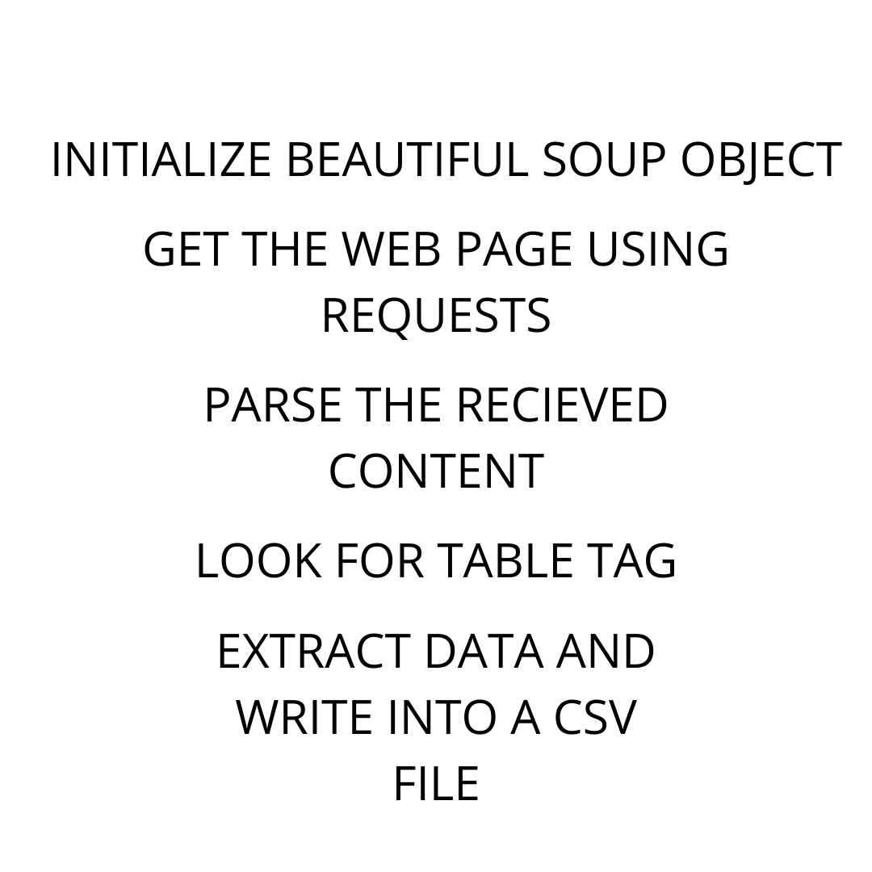
Data Collection - Scraping
WEB SCRAPING SITE: https://en.wikipedia.org/wiki/List_of_Falcon_9_and_Falcon_Heavy_launches
https://github.com/singhkushagra/IBMapplieddatasciencecapstone/blob/93b861fa9afe5c7b0cb757dfcb8e8eb991017892/2-Web%20scraping%20Falcon%209%20and%20Falcon%20Heavy%20Launches%20Records%20from%20Wikipedia.ipynb

Slide 10
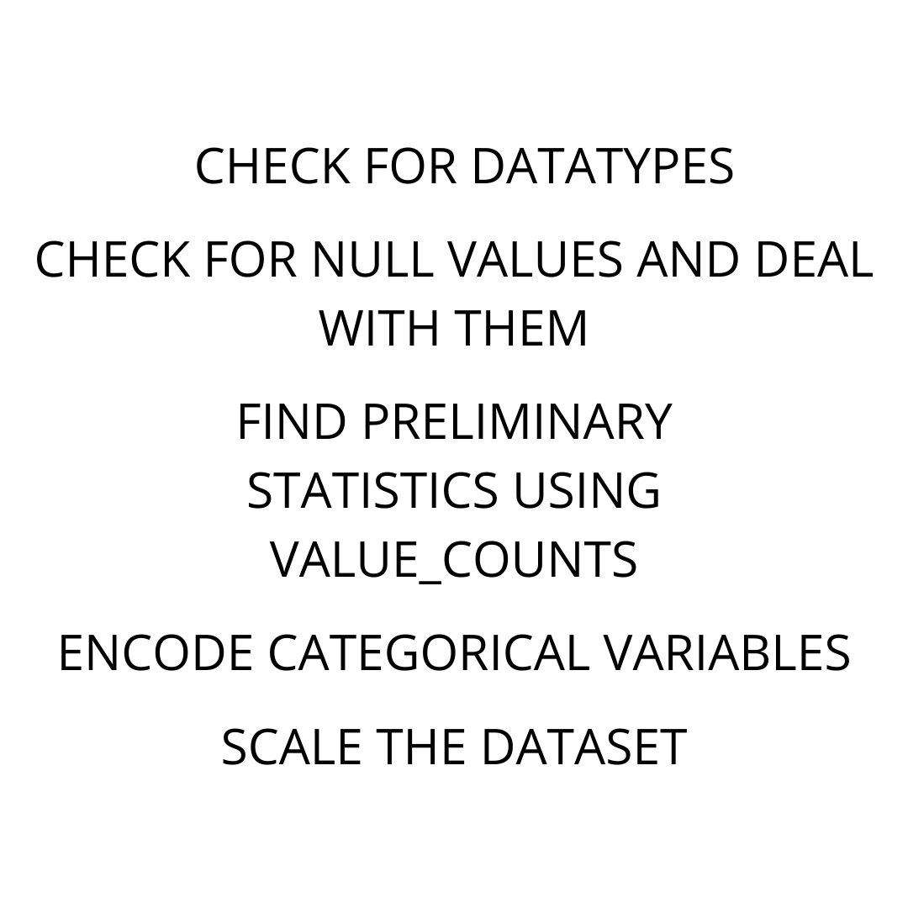
Data Wrangling
Describe how data were processed
https://github.com/singhkushagra/IBMapplieddatasciencecapstone/blob/93b861fa9afe5c7b0cb757dfcb8e8eb991017892/3-Data%20wrangling.ipynb

Slide 11
EDA with Data Visualization
Exploratory Data Analysis with visualization contains scatter point chart with x axis to be Flight Number and y axis to be the launch site, scatter point chart with x axis to be Pay Load Mass (kg) and y axis to be the launch site, bar chart for the success rate of each orbit, scatter point chart with x axis to be Flight Number and y axis to be the Orbit, scatter point chart with x axis to be Payload and y axis to be the Orbit, and launch success yearly trend. These plots show how various variables have been in the past, the trends and patterns.
https://github.com/singhkushagra/IBMapplieddatasciencecapstone/blob/93b861fa9afe5c7b0cb757dfcb8e8eb991017892/5-Exploring%20and%20Preparing%20Data.ipynb

Slide 12
EDA with SQL
SQL queries were used to find unique launch sites, launch sites with a particular name, the most successful launch site etc.
Queries were used to find limits of payloads for success of failure, the most efficient booster, the first date of success or failure.
They are used to find number of success or failure in particular circumstances, launches with a definite payload or in a definite date range, whether they were successful or failure.
https://github.com/singhkushagra/IBMapplieddatasciencecapstone/blob/93b861fa9afe5c7b0cb757dfcb8e8eb991017892/4-SQL%20Notebook%20for%20Peer%20Assignment.ipynb

Slide 13
Build an Interactive Map with Folium
The folium maps include markers that mark the launch sites on the map, along with their co-ordinates. Markers here help us identify the launch sites, clicking on which, each test along with success or failure marked with the marker color. These locations have closest distance markings in lines to highways, railroad and cities, also a closest costal area.
https://github.com/singhkushagra/IBMapplieddatasciencecapstone/blob/93b861fa9afe5c7b0cb757dfcb8e8eb991017892/6-Launch%20Sites%20Locations%20Analysis%20with%20Folium.ipynb

Slide 14
Build a Dashboard with Plotly Dash
The plotly dashboard has a pie chart having statistics of successful or failed launch attempts based on all different sites individually along with all sites statistics. This dashboard also has a scatter plot with a slider that lets us adjust payload range to get successful or failed launch attempts at a particular launch site or for all sites combined.
These plots help users and stakeholders get a idea of success or more importantly, the different outcomes for different set of attributes and how they change.
https://github.com/singhkushagra/IBMapplieddatasciencecapstone/blob/93b861fa9afe5c7b0cb757dfcb8e8eb991017892/7-Build%20an%20Interactive%20Dashboard%20with%20Ploty%20Dash.ipynb

Slide 15
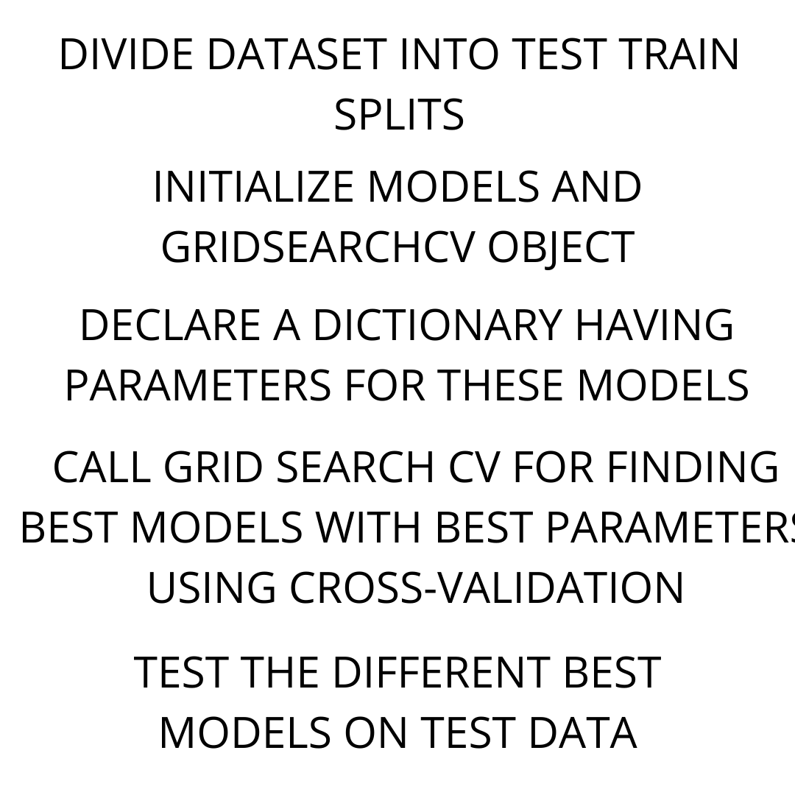
Predictive Analysis (Classification)
FOUR MODELS, INCLUDING KNN, SVM, LOGISTIC REGRESSION AND DECISION TREE WERE USED WITH AN ARRAY OF HYPERPARAMETERS AND CROSS-VALIDATION USING GRID SEARCH CV TO FIND THE BEST MODEL OF ALL FOUR DIFFERENT MODELS. THEN, TEST SET ACCURACY WAS CALCULATED AND CONFUSION MATRIX FOR EACH OF THE BEST MODELS WERE PLOTTED TO IDENTIFY THE BEST PERFORMING MODEL.
https://github.com/singhkushagra/IBMapplieddatasciencecapstone/blob/93b861fa9afe5c7b0cb757dfcb8e8eb991017892/8-Machine%20Learning%20Prediction.ipynb

Slide 16
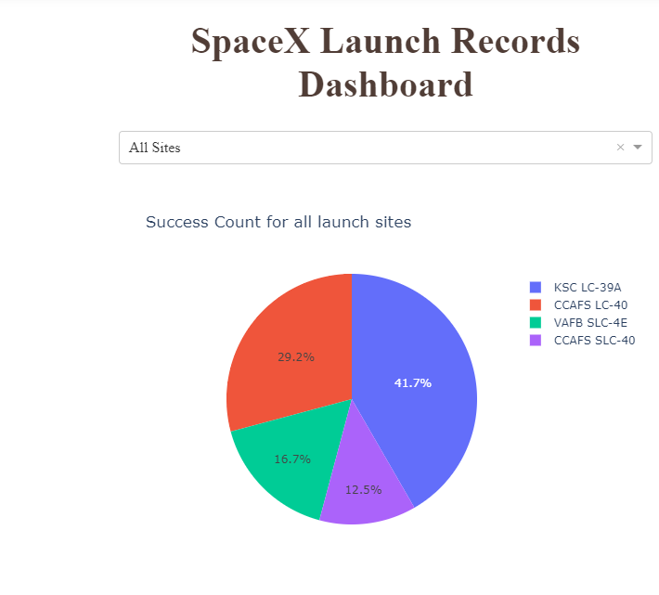
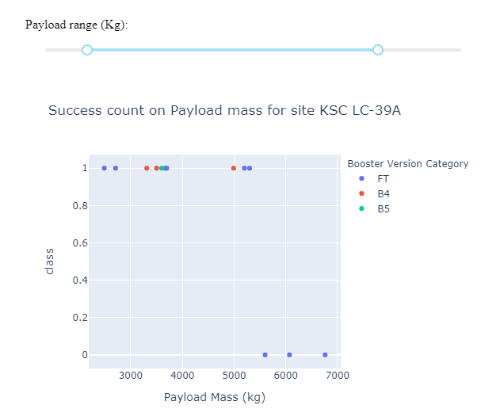
Results
EXPLORATORY ANALYSIS SHOWS THAT THERE IS A CORRELATION BETWEEN VARIOUS FACTORS LIKE PAYLOAD MASS, BOOSTER VERSION, LAUNCH SITE ETC. WITH THE SUCCESS OR FAILURE OF THE LAUNCH TEST. THIS SHOWS THAT WITH PROPER TECHNIQUES, SUCH PATTERNS CAN BE UNCOVERED THAT CAN IN TURN BE USED TO MAXIMIZE OUR RESULTS.
PREDICTIVE ANALYSIS SHOWS THAT ALMOST 80 TO 85 PERCENT OF DATA IS CORRELATED AND THAT THESE MANY TIMES AN INSTANCE CAN BE CORRECTLY PREDICTED TO BE A SUCCESS OR FAILURE. THE MODELS ARE ABLE TO EXPLAIN AROUND 83% VARIANCE IN THE ORIGINAL DATASET WITH WHICH, THEY CAN CALCULATE NEW RELATIONS OR PROJECTED VALUES.

Slide 17

Section 2

Slide 18
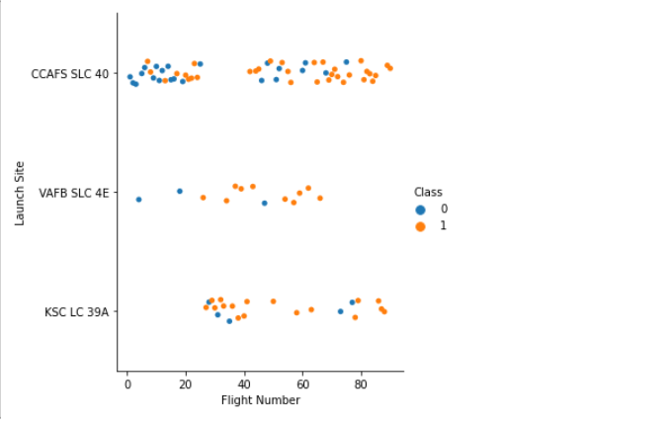
Flight Number vs. Launch Site
HERE, WE SEE SUCCESSES AND FAILURES FROM DIFFERENT LAUNCH SITES AND BASED ON THEIR NUMBER. HERE, YELLOW OR 1 IS SUCCESS AND BLUE OR 0 IS FAILURE.

Slide 19
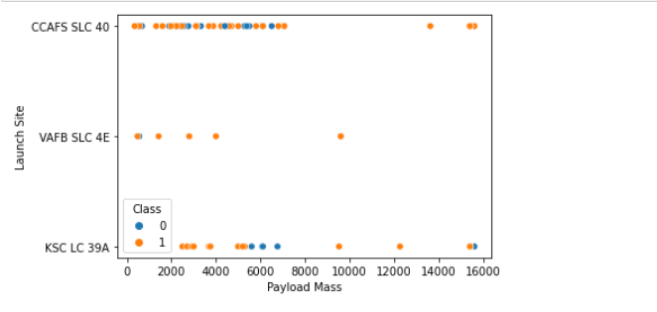
Payload vs. Launch Site
HERE, WE SEE SUCCESSES AND FAILURES FROM DIFFERENT LAUNCH SITES WITH DIFFERENT AMOUNT OF PAYLOADS. HERE, YELLOW OR 1 IS SUCCESS AND BLUE OR 0 IS FAILURE.

Slide 20
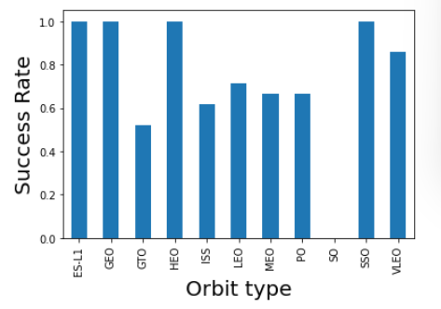
Success Rate vs. Orbit Type
THIS BAR GRAPH SHOWS SUCCESS RATE FOR DIFFERENT ORBIT TYPES.

Slide 21
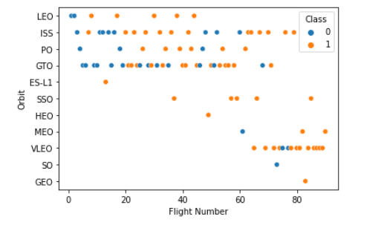
Flight Number vs. Orbit Type
HERE, WE SEE SUCCESSES AND FAILURES FROM DIFFERENT ORBIT TYPE WITH THEIR FLIGHT NUMBER. HERE, YELLOW OR 1 IS SUCCESS AND BLUE OR 0 IS FAILURE.

Slide 22
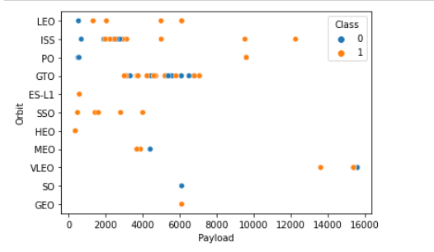
Payload vs. Orbit Type
HERE, WE SEE SUCCESSES AND FAILURES FOR DIFFERENT PAYLOADS WITH DIFFERENT ORBIT TYPE. HERE, YELLOW OR 1 IS SUCCESS AND BLUE OR 0 IS FAILURE.

Slide 23
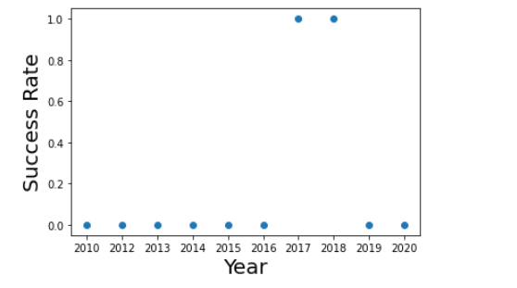
Launch Success Yearly Trend
HERE WE SEE THE SUCCESS RATE BASED ON DIFFERENT YEAR.

Slide 24
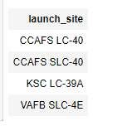
All Launch Site Names
SQL QUERY:
SELECT DISTINCT LAUNCH_SITE
FROM SPACEXTBL;
THIS SELECTS ALL DISTINCT LAUNCH SITES FROM THE TABLE SPACEXTBL.

Slide 25
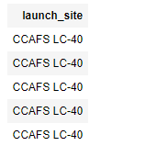
Launch Site Names Begin with 'CCA'
SQL QUERY:
SELECT LAUNCH_SITE
FROM SPACEXTBL
WHERE LAUNCH_SITE LIKE 'CCA%'
LIMIT 5;
THIS QUERY SELECTS 5 LAUNCH SITES WHICH STARTS WITH “CCA”. THE ABSENCE OF DISTINCT HERE RETURN DUPLICATED RESULTS.

Slide 26
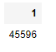
Total Payload Mass
SQL QUERY:
SELECT SUM(PAYLOAD_MASS__KG_)
FROM SPACEXTBL
WHERE Customer = 'NASA (CRS)’;
THIS QUERY SELECTS THE SUM OF PAYLOADS FROM THE TABLE .

Slide 27
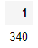
Average Payload Mass by F9 v1.1
SQL QUERY:
SELECT AVG(PAYLOAD_MASS__KG_)
FROM SPACEXTBL
WHERE Booster_Version LIKE 'F9 v1.0%’;
THIS QUERY SELECTS AVERAGE PAYLOAD MASS WHERE BOOSTER VERSION HAS NAME STARTING WITH ‘F9 v1.0%’

Slide 28
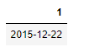
First Successful Ground Landing Date
SQL QUERY:
SELECT MIN(Date)
FROM SPACEXTBL
WHERE Landing_Outcome = 'Success (ground pad)’;
THIS QUERY SELECTS THE MINIMUM I.E. THE FIRST DATE OF A SUCCESSFUL LAUNCH OUTCOME.

Slide 29
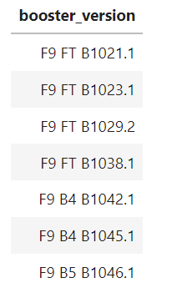
Booster Version of Successful Drone Ship Landing with Payload between 4000 and 6000
SELECT BOOSTER_VERSION
FROM SPACEXTBL
WHERE LANDING_OUTCOME = 'Success (drone ship)'
AND 4000 < PAYLOAD_MASS_KG < 6000;
HERE, WE SELECT THE BOOSTER VERSION FOR SUCCESSFUL LAUNCH WITH A SPECIFIC PAYLOAD.

Slide 30
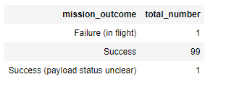
Total Number of Successful and Failure Mission Outcomes
SQL QUERY:
SELECT MISSION_OUTCOME, COUNT(MISSION_OUTCOME) AS TOTAL_NUMBER
FROM SPACEXTBL
GROUP BY MISSION_OUTCOME;
THIS QUERY SELECTS THE NUMBER OF MISSIONS.

Slide 31
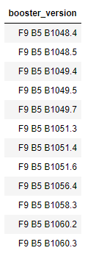
Boosters Carried Maximum Payload
SELECT DISTINCT BOOSTER_VERSION
FROM SPACEXTBL
WHERE PAYLOAD_MASS__KG_ = (
SELECT MAX(PAYLOAD_MASS__KG_)
FROM SPACEXTBL);
HERE, WE SELECT THE BOOSTER HAVING THE MAXIMUM PAYLOAD.

Slide 32
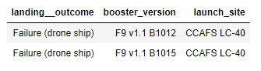
2015 Launch Records
SELECT LANDING__OUTCOME, BOOSTER_VERSION, LAUNCH_SITE
FROM SPACEXTBL
WHERE Landing__Outcome = 'Failure (drone ship)'
AND YEAR(DATE) = 2015;

Slide 33
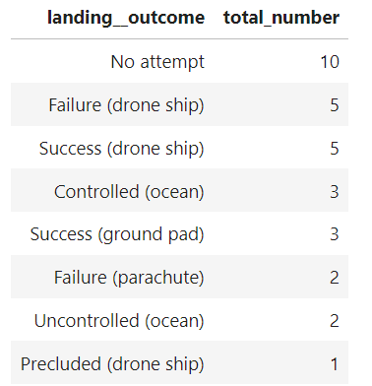
Rank Landing Outcomes Between 2010-06-04 and 2017-03-20
SELECT LANDING_OUTCOME, COUNT(LANDING__OUTCOME) AS TOTAL_NUMBER
FROM SPACEXTBL
WHERE DATE BETWEEN '2010-06-04' AND '2017-03-20'
GROUP BY LANDING_OUTCOME
ORDER BY TOTAL_NUMBER DESC

Slide 34

Section 3

Slide 35
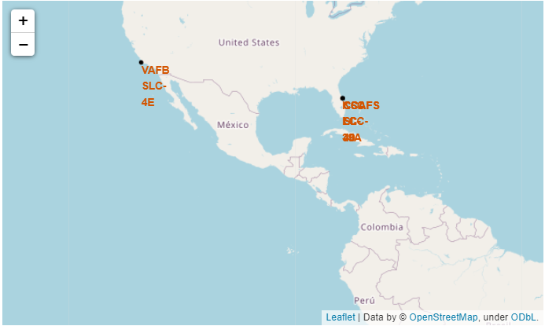
ALL LAUNCH SITES’ LOCATION MARKERS
HERE, ALL THE LAUNCH SITES ARE LISTED ON THE MAP. AS IS EVIDENT FROM THE FIGURE, ALL LAUNCH SITES ARE ON THE COASTAL AREAS OF UNITED STATES, PROBABLY TO REDUCE COLLATERAL IN CASE OF A FAILURE AND TO LEVERAGE THE OCEAN BREEZES FOR TAKE-OFF.

Slide 36
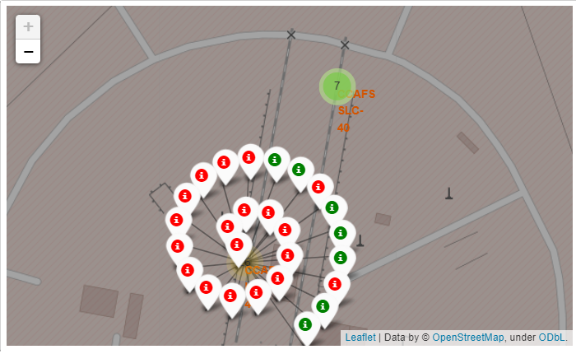
LAUNCH OUTCOME ON SITES
THE FOLLOWING FIGURE SHOWS THE COLOR MARKED PRECISE LOCATION IN SIDE THE LAUNCH SITE APPROXIAMATED AREA. HERE GREEN DEPICTS SUCCESS AND RED DEPICT FAILURE.

Slide 37
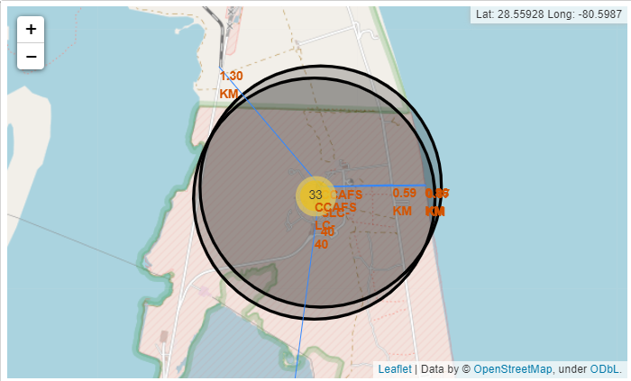
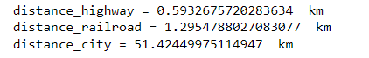
PROXIMITIES
THE FOLLOWING FIGURE SHOWS NEAREST HIGHWAY BEING 0.59 KMs AWAY, NEAREST RAILROAD BEING 1.29 KMs AWAY AND CITY BEING 51.42 KMs AWAY. THE DISTANCE OF CITY SUGGESTS SAFETY MEASURES AGAINST DEBRIS OF FAILED LAUNCHES.

Slide 38

Section 4

Slide 39
LAUNCH SUCCESS COUNT FOR ALL SITES
THE RESPECTIVE SCREENSHOT SHOWS 41.7% SUCCESS LAUNCHES FROM THE LAUNCH SITE KSC LC-39A, FOLLOWED BY 29.2% SUCCESS LAUNCHES FROM CCAFS LC-40, 16.7% SUCCESS LAUNCHES FROM VAFB SLC-4E AND 12.5% SUCCESS LAUNCHES FROM CCAFS SLC-40.

Slide 40
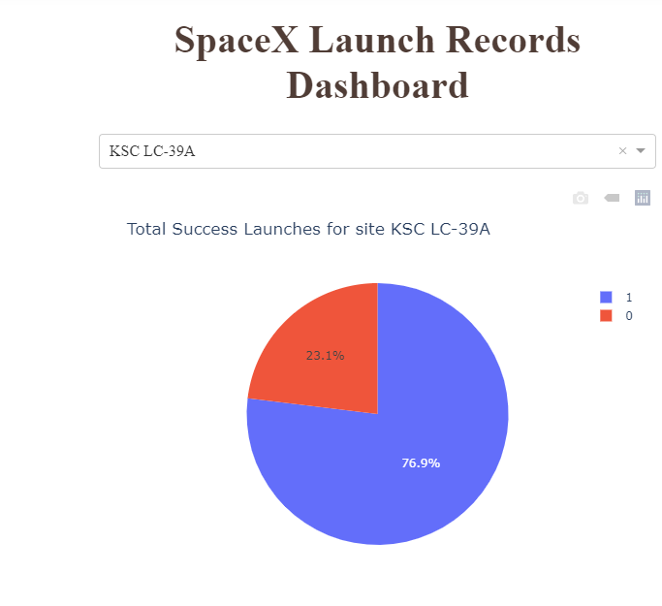
SUCCESS AND FAILURE FOR MOST SUCCESSFUL LAUNCH SITE
THE FOLLOWING PIE CHART SHOWS 76.9% SUCCESSFUL LAUNCHES AS COMPARED TO THE 23.1% FAILURES FROM THE MOST SUCCESSFUL SITE KSC LC-39A. HERE 1 STANDS FOR SUCCESS AND 0 STANDS FOR FAILURE.

Slide 41
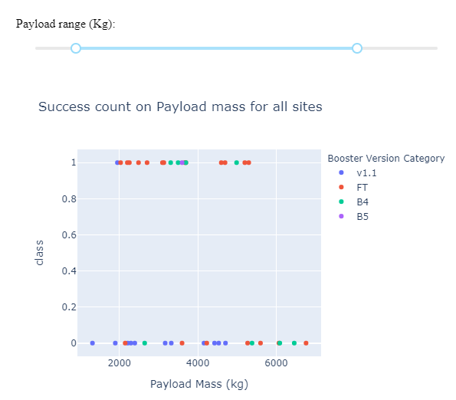
Payload vs. Launch Outcome
THE FIGURE SHOWS SUCCESS COUNTS OF LAUNCHES FROM ALL LAUNCH SITES FOR DIFFERENT PAYLOAD MASS RANGE(IN KG). HERE, 1 SHOWS SUCCESS FOR DIFFERENT BOOSTER VERSION CATEGORIES AND 0 SHOWS FAILURES.

Slide 42

Section 5

Slide 43
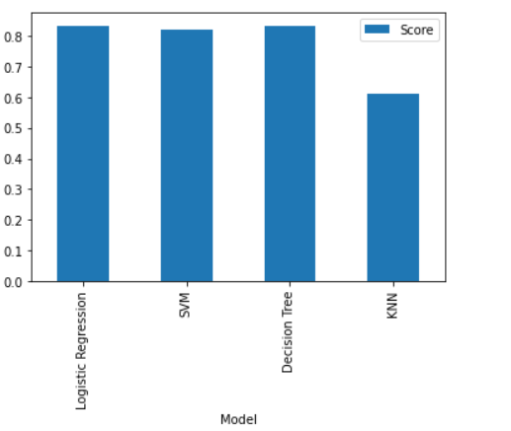
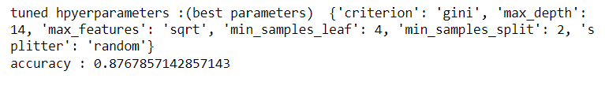
Classification Accuracy
ACCORDING TO THE COMPARISION OF TEST SET ACCURACY OF ALL THE FOUR MODELS, DECISION TREE, AND LOGISTIC REGRESSION SEEM TO PERFOM THE BEST. SCORE=83.333(DECISION TREE)

Slide 44
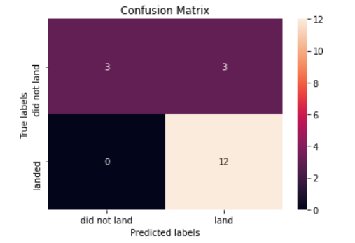
Confusion Matrix
THE FOLLOWING CONFUSION MATRIC OF DECISION TREE SHOWS THAT 12 INSTANCES THAT WERE PREDICTED TO LAND ACTUALLY LANDED, AND OUT 3 NOT TO HAVE BEEN PREDICTED TO LAND DIDN’T LAND. THE PROBLEM HERE IS 3 MISS-CLASSIFICATIONS THAT WERE PREDICTED TO LAND BUT DIDN’T IN REALITY.

Slide 45
Conclusions
IF UNSEEN DATA WERE TO BE FED TO OUR MODEL, WE CAN BE ABOUT 83% CERTAIN THAT IT WOULD YIELD US CORRECT PREDICTIONS.
KSC LC39-C WAS THE LAUNCH SITE WITH MOST OF THE SUCCESSFUL LAUNCHES.
SUCCESSFUL LAUNCHES DEPEND HUGELY ON PARAMETERS SUCH AS PAYLOAD MASS ETC.
MOST OF THE LAUNCH SITES ARE ON COSTAL AREAS, AWAY FROM CITIES.

Slide 46
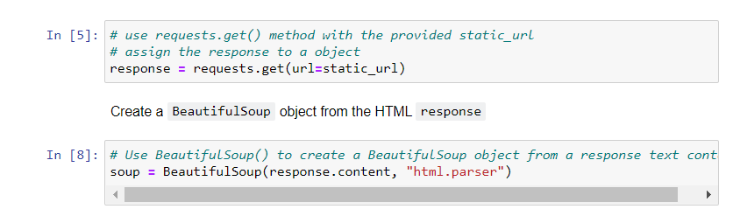
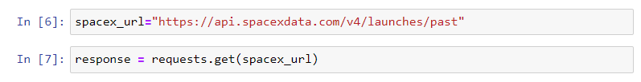
Appendix

Slide 47


